Slide 1


Slide 2


Ambulance Booking App
Pre-Final Year Project Synopsis
Submitted by
ROLL | NAME
2201010136 | Tanishq
2201010137 | Garima
2201010140 | Dilasha
2201010166 | Mehak
Industry Mentor: Himanshu aggarwal
Faculty Mentor: Dr. Yogita Yashveer raghav
Notes:
New Courses replaced with New Programmes

Slide 3
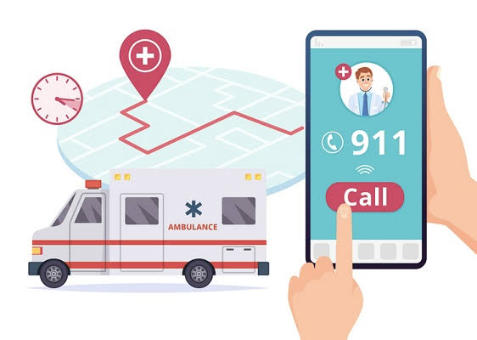
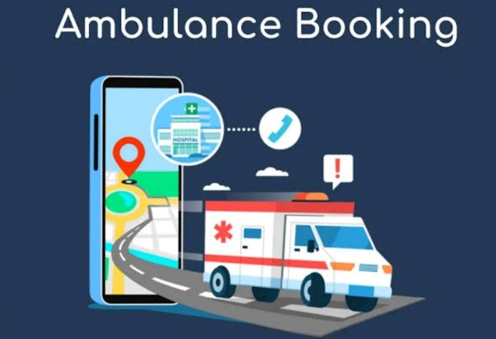

Project Overview
The "Ambulance Booking System App" is a critical solution designed to streamline and optimize the process of requesting and dispatching ambulance services in times of medical emergencies. This innovative application leverages technology to provide rapid, efficient, and life-saving assistance to individuals in need.
It offers a user-friendly interface for users to request ambulance services swiftly, connecting them with nearby medical facilities and emergency response teams.
The app not only enhances response times but also ensures the timely and effective deployment of ambulances, ultimately contributing to improved healthcare outcomes and public safety.
With our innovative application, users can now conveniently book ambulances with just a few taps on their smartphones. Say goodbye to the hassle of making phone calls or waiting for an ambulance to arrive.
Notes:
New Courses replaced with New Programmes

Slide 4

Specific Objectives
Quick Booking: Enable users to book an ambulance instantly via a mobile app.
Faster Response Time: Reduce delays by connecting users with the nearest available ambulance.
Seamless Communication: Facilitate direct communication between patients, ambulance drivers, and hospitals.
Multiple Ambulance Options: Offer different types of ambulances based on medical needs.
Emergency Alerts: Notify hospitals and medical teams about incoming patients.
User-Friendly Interface: Ensure an intuitive design for hassle-free booking.
Data Storage & Management: Maintain patient history and booking records for future reference.
Enhanced Public Safety: Improve emergency medical response and overall healthcare accessibility.
Notes:
New Courses replaced with New Programmes

Slide 5
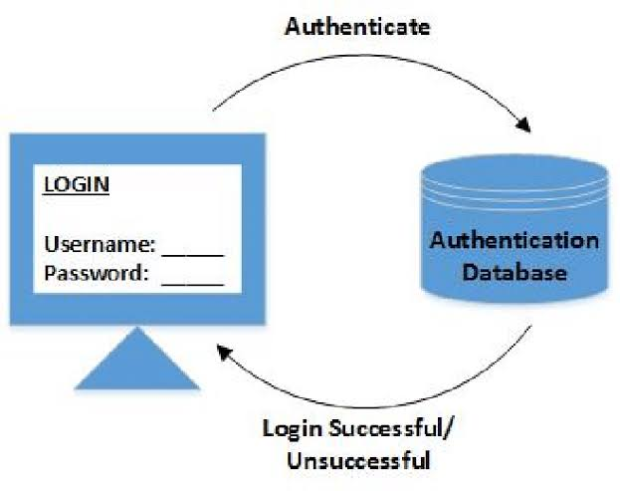
Key Features
Admin Panel
Login & authentication
Approve ambulance registrations
View and manage user details
User Module
Register & login
Send ambulance requests
Manage personal profile
Ambulance Provider
Register & login
Create and manage ambulance
Listings
Approve ambulance
Notes:
New Courses replaced with New Programmes

Slide 6
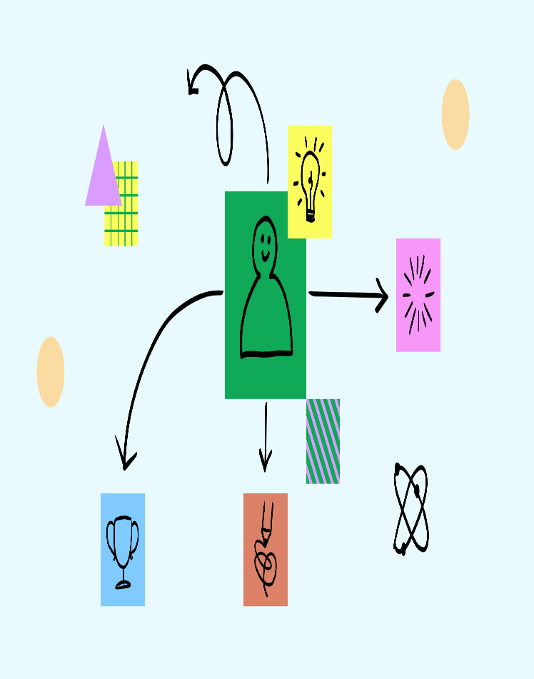
Project Usecases & Scope
Use cases
User Requests Ambulance – Users search for and request an ambulance based on location.
Admin Manages Ambulances – Admin approves ambulances and monitors user details.
Ambulance Provider Handles Requests – Ambulance operators accept request.
2. Scope
Emergency Response – Fast and efficient ambulance booking during medical emergencies.
User-Friendly Interface – Easy registration, booking, and management.
Notes:
New Courses replaced with New Programmes

Slide 7
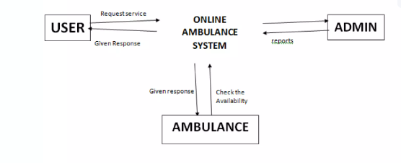
Prototype/Project Flow diagram/Architecture
System Components:
Server (central hub connecting various functions).
Controller (possibly manages traffic or vehicle coordination).
List all hospital/medical facilities (helps in decision-making).
Nearest ambulance (identifies the closest available ambulance).
The system ensures quick and efficient emergency response by integrating GPS tracking, real-time data, and route optimization.
Notes:
New Courses replaced with New Programmes

Slide 8
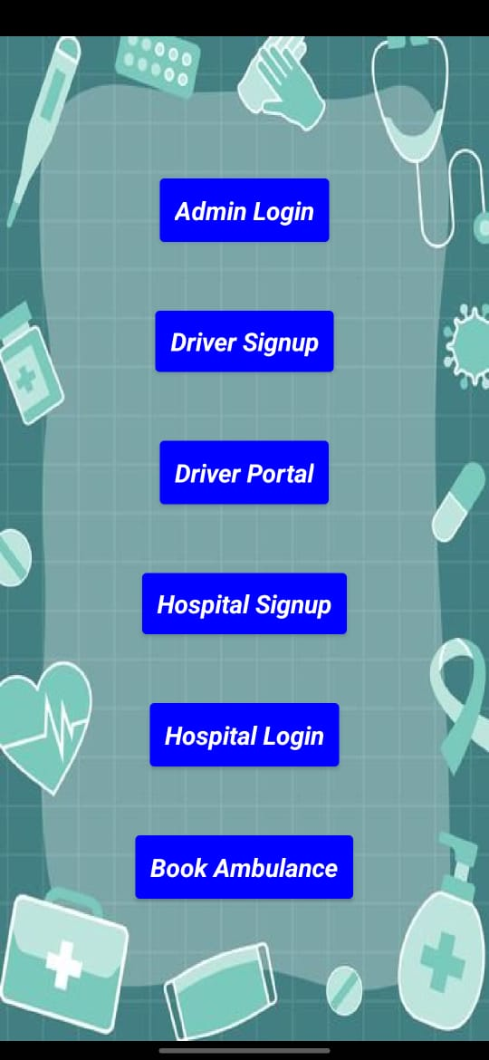
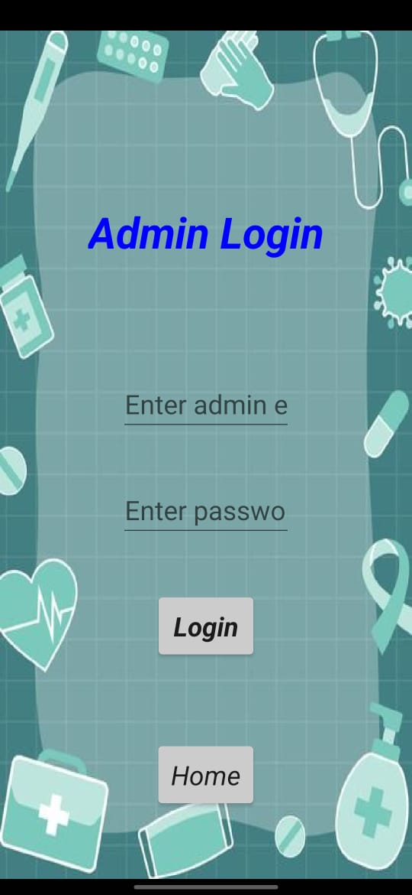
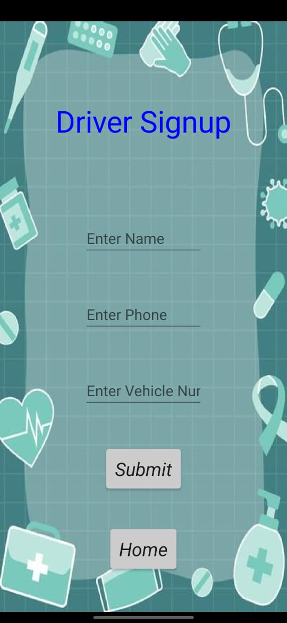

Slide 9
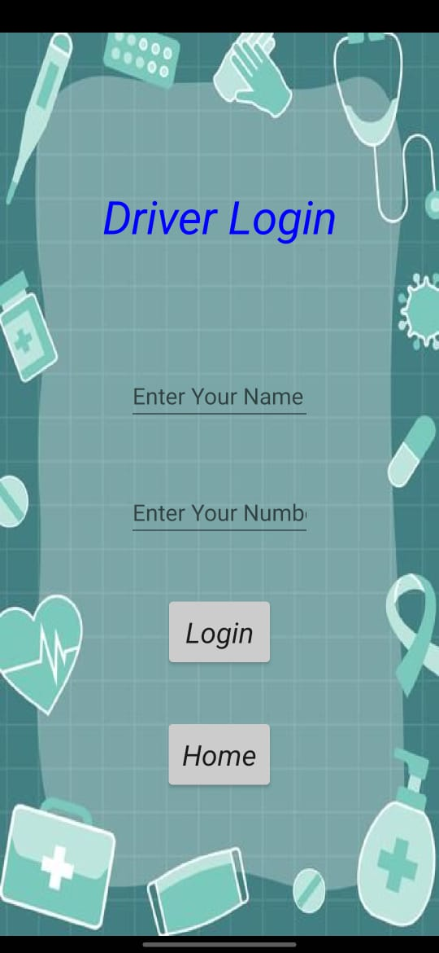
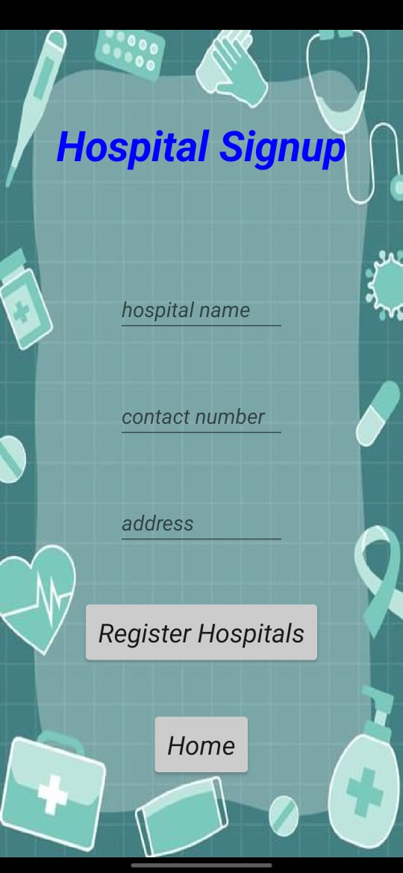
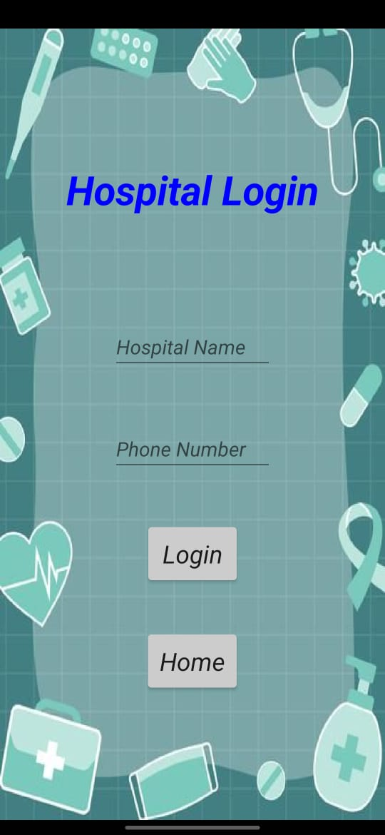

Slide 10
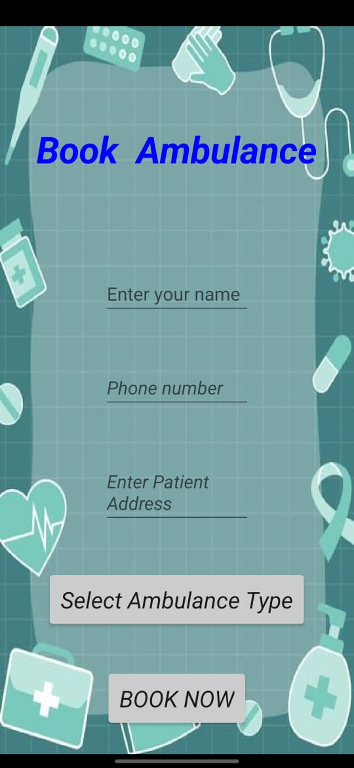
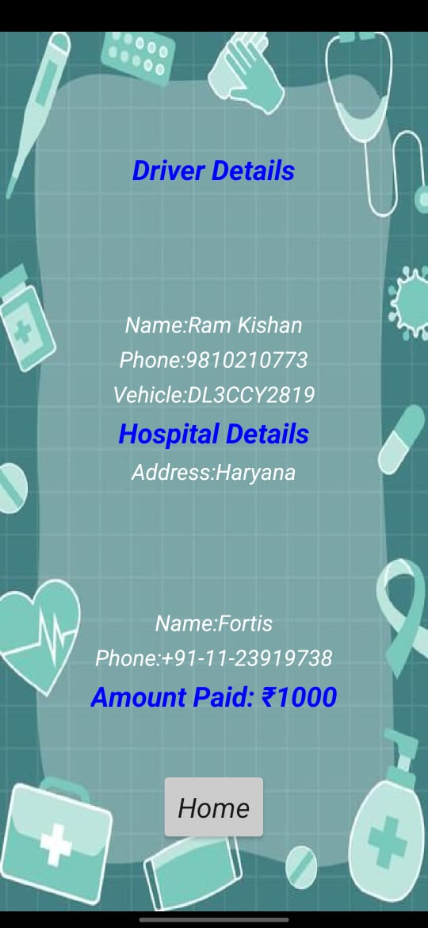

Slide 11
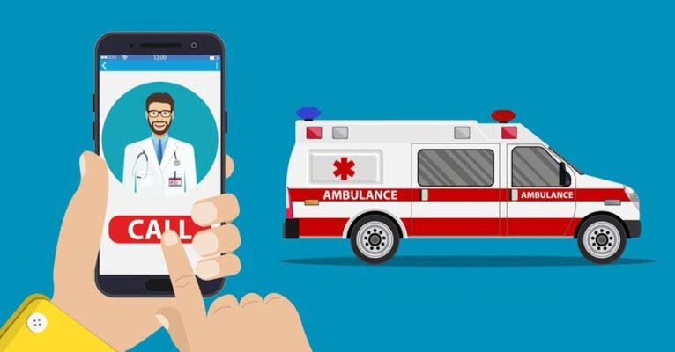
Data & Resources
1.Ambulance Data:
User-Provided Data: Ambulance type, availability, service charges, and photos.
External APIs: Integration with hospital databases for real-time availability.
2. User Data: Profile Information: Name, contact details.
Notes:
New Courses replaced with New Programmes

Slide 12
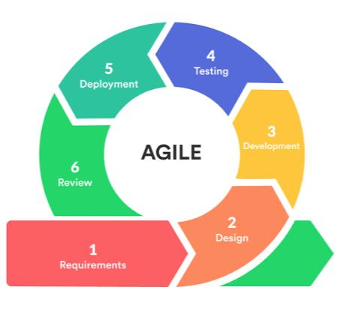
Methodology
The project will follow an agile development approach, enabling iterative improvements based on user feedback. Initially, user research will identify key challenges in existing ambulance booking systems. A prototype will be developed featuring automated dispatch and emergency contact notifications. User testing will refine the interface and ensure seamless operation. Security measures, including patient data encryption and verified driver credentials, will be implemented to enhance trust. Finally, the system will be launched in phases, with continuous monitoring and updates based on user engagement and emerging requirements.
Notes:
New Courses replaced with New Programmes

Slide 13
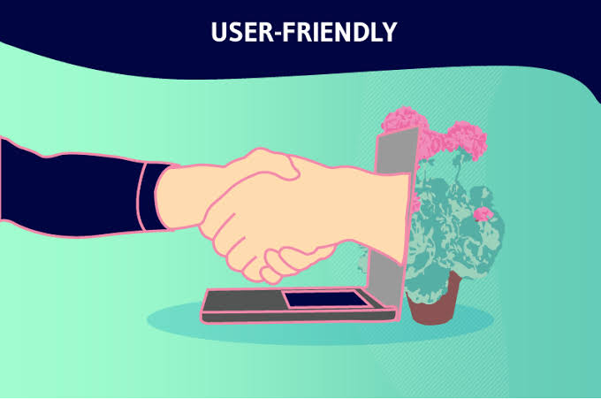
Expected Results & Impact
➤ In this project and if it work expected then it will be very successful application which will be useful in our day to day life. And according with Ambulance Booking App will be able to go one step forward in health sector also. In this project, an idea is developed for saving a patient's life in a fasted way as possible.
➤ It is very important for users in case of emergencies as it saves time. With this Application, the ambulance can reach to the user or patient as location is tracked or given through the application and also can provide necessary equipment's which is required for the patient's health.
➤ It includes the creation and implementation of a prototype to demonstrate the system's functionality and effectiveness in comparison to existing systems.
➤ The developers believe that implementing this system could simplify the lives of people in such areas and prevent avoidable deaths during emergencies.
Notes:
New Courses replaced with New Programmes

Slide 14
THANK YOU

